Slide 1
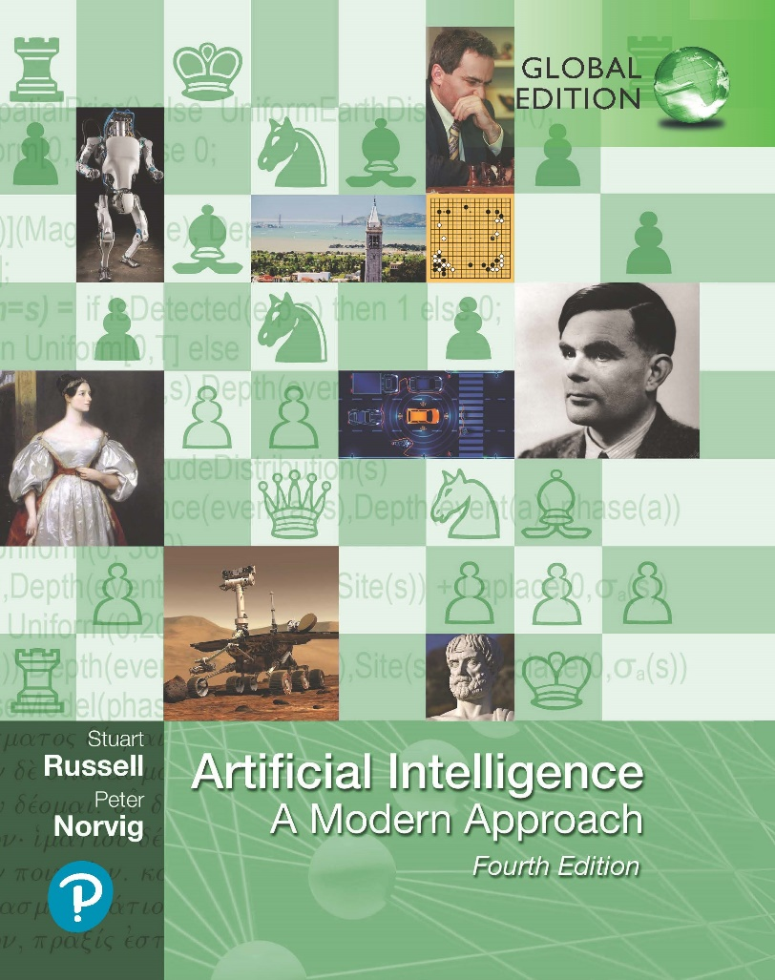
Artificial Intelligence: A Modern Approach
Fourth Edition, Global Edition
Chapter 1
Introduction

Slide 2
Artificial Intelligence
Chapter 1

Slide 3
Outline
What is AI?
A brief history
The state of the art

Slide 4
What is AI?
Systems that think like humans | Systems that think rationally
Systems that act like humans | Systems that act rationally

Slide 5
Acting humanly: The Turing test
Turing (1950) “Computing machinery and intelligence”:
“Can machines think?” −→ “Can machines behave intelligently?”
Operational test for intelligent behavior: the Imitation Game
HUMAN
HUMAN INTERROGATOR
?
AI SYSTEM
Predicted that by 2000, a machine might have a 30% chance of fooling a lay person for 5 minutes
Anticipated all major arguments against AI in following 50 years
Suggested major components of AI: knowledge, reasoning, language understanding, learning
Problem: Turing test is not reproducible, constructive, or amenable to mathematical analysis

Slide 6
Thinking humanly: Cognitive Science
1960s “cognitive revolution”: information-processing psychology replaced prevailing orthodoxy of behaviorism
Requires scientific theories of internal activities of the brain
What level of abstraction? “Knowledge” or “circuits”?
How to validate? Requires
Predicting and testing behavior of human subjects (top-down) or 2) Direct identification from neurological data (bottom-up)
Both approaches (roughly, Cognitive Science and Cognitive Neuroscience) are now distinct from AI
Both share with AI the following characteristic:
the available theories do not explain (or engender) anything resembling human-level general intelligence
Hence, all three fields share one principal direction!

Slide 7
Thinking rationally: Laws of Thought
Normative (or prescriptive) rather than descriptive
Aristotle: what are correct arguments/thought processes? Several Greek schools developed various forms of logic:
notation and rules of derivation for thoughts;
may or may not have proceeded to the idea of mechanization
Direct line through mathematics and philosophy to modern AI Problems:
Not all intelligent behavior is mediated by logical deliberation
What is the purpose of thinking? What thoughts should I have out of all the thoughts (logical or otherwise) that I could have?

Slide 8
Acting rationally
Rational behavior: doing the right thing
The right thing: that which is expected to maximize goal achievement, given the available information
Doesn’t necessarily involve thinking—e.g., blinking reflex—but thinking should be in the service of rational action
Aristotle (Nicomachean Ethics):
Every art and every inquiry, and similarly every action and pursuit, is thought to aim at some good

Slide 9
Rational agents
An agent is an entity that perceives and acts
This course is about designing rational agents
Abstractly, an agent is a function from percept histories to actions:
f : P∗ → A
For any given class of environments and tasks, we seek the agent (or class of agents) with the best performance
Caveat: computational limitations make perfect rationality unachievable
→ design best program for given machine resources

Slide 10
AI prehistory
Philosophy
logic, methods of reasoning mind as physical system
foundations of learning, language, rationality
formal representation and proof
algorithms, computation, (un)decidability, (in)tractability probability
adaptation
phenomena of perception and motor control experimental techniques (psychophysics, etc.)
formal theory of rational decisions knowledge representation grammar
plastic physical substrate for mental activity
Mathematics
Psychology
Economics Linguistics
Neuroscience
Control theory homeostatic systems, stability
simple optimal agent designs

Slide 11
Potted history of AI
1943
1950
McCulloch & Pitts: Boolean circuit model of brain Turing’s “Computing Machinery and Intelligence”
1952–69 Look, Ma, no hands!
1950s
Early AI programs, including Samuel’s checkers program, Newell & Simon’s Logic Theorist, Gelernter’s Geometry Engine Dartmouth meeting: “Artificial Intelligence” adopted Robinson’s complete algorithm for logical reasoning
1956
1965
1966–74 AI discovers computational complexity Neural network research almost disappears
1969–79 Early development of knowledge-based systems 1980–88 Expert systems industry booms
1988–93 Expert systems industry busts: “AI Winter” 1985–95 Neural networks return to popularity
1988–
Resurgence of probability; general increase in technical depth “Nouvelle AI”: ALife, GAs, soft computing
Agents, agents, everywhere . . .
Human-level AI back on the agenda
1995–
2003–

Slide 12
State of the art
Which of the following can be done at present?
Play a decent game of table tennis

Slide 13
State of the art
Which of the following can be done at present?
Play a decent game of table tennis
Drive safely along a curving mountain road

Slide 14
State of the art
Which of the following can be done at present?
Play a decent game of table tennis
Drive safely along a curving mountain road
Drive safely along Telegraph Avenue

Slide 15
State of the art
Which of the following can be done at present?
Play a decent game of table tennis
Drive safely along a curving mountain road
Drive safely along Telegraph Avenue
Buy a week’s worth of groceries on the web

Slide 16
State of the art
Which of the following can be done at present?
Play a decent game of table tennis
Drive safely along a curving mountain road
Drive safely along Telegraph Avenue
Buy a week’s worth of groceries on the web
Buy a week’s worth of groceries at Berkeley Bowl

Slide 17
State of the art
Which of the following can be done at present?
Play a decent game of table tennis
Drive safely along a curving mountain road
Drive safely along Telegraph Avenue
Buy a week’s worth of groceries on the web
Buy a week’s worth of groceries at Berkeley Bowl
Play a decent game of bridge

Slide 18
State of the art
Which of the following can be done at present?
Play a decent game of table tennis
Drive safely along a curving mountain road
Drive safely along Telegraph Avenue
Buy a week’s worth of groceries on the web
Buy a week’s worth of groceries at Berkeley Bowl
Play a decent game of bridge
Discover and prove a new mathematical theorem

Slide 19
State of the art
Which of the following can be done at present?
Play a decent game of table tennis
Drive safely along a curving mountain road
Drive safely along Telegraph Avenue
Buy a week’s worth of groceries on the web
Buy a week’s worth of groceries at Berkeley Bowl
Play a decent game of bridge
Discover and prove a new mathematical theorem
Design and execute a research program in molecular biology

Slide 20
State of the art
Which of the following can be done at present?
Play a decent game of table tennis
Drive safely along a curving mountain road
Drive safely along Telegraph Avenue
Buy a week’s worth of groceries on the web
Buy a week’s worth of groceries at Berkeley Bowl
Play a decent game of bridge
Discover and prove a new mathematical theorem
Design and execute a research program in molecular biology
Write an intentionally funny story

Slide 21
State of the art
Which of the following can be done at present?
Play a decent game of table tennis
Drive safely along a curving mountain road
Drive safely along Telegraph Avenue
Buy a week’s worth of groceries on the web
Buy a week’s worth of groceries at Berkeley Bowl
Play a decent game of bridge
Discover and prove a new mathematical theorem
Design and execute a research program in molecular biology
Write an intentionally funny story
Give competent legal advice in a specialized area of law

Slide 22
State of the art
Which of the following can be done at present?
Play a decent game of table tennis
Drive safely along a curving mountain road
Drive safely along Telegraph Avenue
Buy a week’s worth of groceries on the web
Buy a week’s worth of groceries at Berkeley Bowl
Play a decent game of bridge
Discover and prove a new mathematical theorem
Design and execute a research program in molecular biology
Write an intentionally funny story
Give competent legal advice in a specialized area of law
Translate spoken English into spoken Swedish in real time

Slide 23
State of the art
Which of the following can be done at present?
Play a decent game of table tennis
Drive safely along a curving mountain road
Drive safely along Telegraph Avenue
Buy a week’s worth of groceries on the web
Buy a week’s worth of groceries at Berkeley Bowl
Play a decent game of bridge
Discover and prove a new mathematical theorem
Design and execute a research program in molecular biology
Write an intentionally funny story
Give competent legal advice in a specialized area of law
Translate spoken English into spoken Swedish in real time
Converse successfully with another person for an hour

Slide 24
State of the art
Which of the following can be done at present?
Play a decent game of table tennis
Drive safely along a curving mountain road
Drive safely along Telegraph Avenue
Buy a week’s worth of groceries on the web
Buy a week’s worth of groceries at Berkeley Bowl
Play a decent game of bridge
Discover and prove a new mathematical theorem
Design and execute a research program in molecular biology
Write an intentionally funny story
Give competent legal advice in a specialized area of law
Translate spoken English into spoken Swedish in real time
Converse successfully with another person for an hour
Perform a complex surgical operation

Slide 25
State of the art
Which of the following can be done at present?
Play a decent game of table tennis
Drive safely along a curving mountain road
Drive safely along Telegraph Avenue
Buy a week’s worth of groceries on the web
Buy a week’s worth of groceries at Berkeley Bowl
Play a decent game of bridge
Discover and prove a new mathematical theorem
Design and execute a research program in molecular biology
Write an intentionally funny story
Give competent legal advice in a specialized area of law
Translate spoken English into spoken Swedish in real time
Converse successfully with another person for an hour
Perform a complex surgical operation
Unload any dishwasher and put everything away

Slide 26
State of the art
Which of the following can be done at present?
Play a decent game of table tennis
Drive safely along a curving mountain road
Drive safely along Telegraph Avenue
Buy a week’s worth of groceries on the web
Buy a week’s worth of groceries at Berkeley Bowl
Play a decent game of bridge
Discover and prove a new mathematical theorem
Design and execute a research program in molecular biology
Write an intentionally funny story
Give competent legal advice in a specialized area of law
Translate spoken English into spoken Swedish in real time
Converse successfully with another person for an hour
Perform a complex surgical operation
Unload any dishwasher and put everything away

Slide 27
Risks and Benefits of AI
“First solve AI, then use AI to solve everything else.” Demis Hassabis, CEO of Google DeepMind
Benefits:
Decrease repetitive work
Increase production of goods and services
Accelerate scientific research (disease cures, climate change and resource shortages solutions)
Risks:
Lethal autonomous weapons
Surveillance and persuasion
Biased decision making
Impact on employment
Safety-critical applications
Cybersecurity threats

Slide 28
Risks and Benefits of AI
Development of an artificial superintelligence that surpasses human intelligence may pose a significant risk
Analogous to the “Gorilla problem”
Humans and gorillas evolved from the same species, but humans have more control than other primates.
Thus, we should design AI systems in such a way that they do not end up taking control in the way that Turing suggests they might.

